Slide 1
Reinforcement learning
Lecture 16
https://www.javatpoint.com/reinforcement-learning
https://www.geeksforgeeks.org/what-is-reinforcement-learning

Slide 2
Reinforcement learning
Reinforcement learning is an area of Machine Learning. It is about taking suitable action to maximize reward in a particular situation
Reinforcement learning differs from supervised learning in a way that in supervised learning the training data has the answer key with it so the model is trained with the correct answer itself.
Whereas in reinforcement learning, there is no answer but the reinforcement agent decides what to do to perform the given task. In the absence of a training dataset, it is bound to learn from its experience.
Reinforcement learning is an autonomous, self-teaching system that essentially learns by trial and error. It performs actions with the aim of maximizing rewards, or in other words, it is learning by doing in order to achieve the best outcomes.

Slide 3
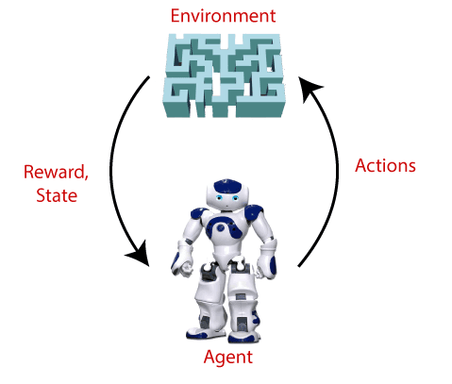
In Reinforcement Learning, the agent learns automatically using feedbacks without any labeled data, unlike supervised learning.
RL solves a specific type of problem where decision making is sequential, and the goal is long-term, such as game-playing, robotics, etc.

Slide 4
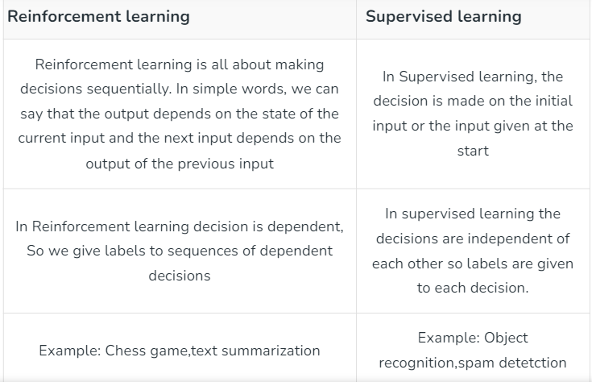
Difference

Slide 5
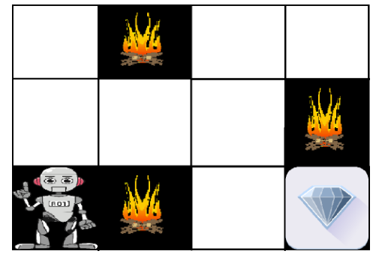
Example:
The problem is as follows: We have an agent and a reward, with many hurdles in between. The agent is supposed to find the best possible path to reach the reward. The following problem explains the problem more easily.

Slide 6
The image shows the robot, diamond, and fire.
The goal of the robot is to get the reward that is the diamond and avoid the hurdles that are fired.
The robot learns by trying all the possible paths and then choosing the path which gives him the reward with the least hurdles.
Each right step will give the robot a reward and each wrong step will subtract the reward of the robot.
The total reward will be calculated when it reaches the final reward that is the diamond.

Slide 7
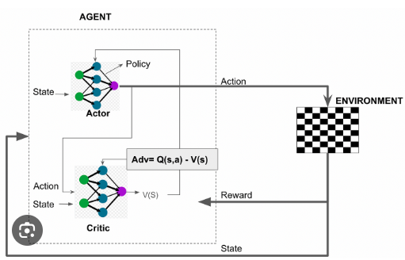
Actor - Critic Reinforcement learning

Slide 8
Main points in Reinforcement learning –
Input: The input should be an initial state from which the model will start
Output: There are many possible outputs as there are a variety of solutions to a particular problem
Training: The training is based upon the input, The model will return a state and the user will decide to reward or punish the model based on its output. The model keeps continues to learn.
The best solution is decided based on the maximum reward.

Slide 9
Main points in Reinforcement learning –
Agent(): An entity that can perceive/explore the environment and act upon it.
Environment(): A situation in which an agent is present or surrounded by. In RL, we assume the stochastic environment, which means it is random in nature.
Action(): Actions are the moves taken by an agent within the environment.
State(): State is a situation returned by the environment after each action taken by the agent.
Reward(): A feedback returned to the agent from the environment to evaluate the action of the agent.
Policy(): Policy is a strategy applied by the agent for the next action based on the current state.
Value(): It is expected long-term retuned with the discount factor and opposite to the short-term reward.
Q-value(): It is mostly similar to the value, but it takes one additional parameter as a current action (a).

Slide 10
Elements of Reinforcement Learning
Reinforcement learning elements are as follows:
Policy
Reward function
Value function
Model of the environment

Slide 11
Elements of Reinforcement Learning
Policy: Policy defines the learning agent behavior for given time period. It is a mapping from perceived states of the environment to actions to be taken when in those states.
Reward function: Reward function is used to define a goal in a reinforcement learning problem. A reward function is a function that provides a numerical score based on the state of the environment.
Value function: Value functions specify what is good in the long run. The value function gives information about how good the situation and action are and how much reward an agent can expect
Model of the environment: Models are used for planning, which mimics the behavior of the environment.

Slide 12
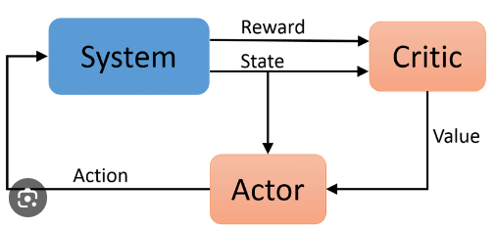

Slide 13
Various Practical Applications of Reinforcement Learning –
RL can be used in large environments in the following situations:
A model of the environment is known, but an analytic solution is not available;
Only a simulation model of the environment is given (the subject of simulation-based optimization)
The only way to collect information about the environment is to interact with it.

Slide 14
Disadvantages of Reinforcement learning
Reinforcement learning is not preferable to use for solving simple problems.
Reinforcement learning needs a lot of data and a lot of computation
Reinforcement learning is highly dependent on the quality of the reward function. If the reward function is poorly designed, the agent may not learn the desired behavior.
Reinforcement learning can be difficult to debug and interpret. It is not always clear why the agent is behaving in a certain way, which can make it difficult to diagnose and fix problems.

